Slide 1
Mental Health In Workplace
My Mission Statement: Assist employees and companies to decrease mental health in workplace.
Zid: z5143964
Name: Peiguo Guan

Slide 2
Problems and Solutions
The Solution:
Based on the dataset which from 2014 to 2016.
Features like age, gender, mental health history country as well as different kinds of attitudes toward workplace
3. Train model set and Test model set.
04
The Problem
Low productivity
Mentally and physically disease

Slide 3
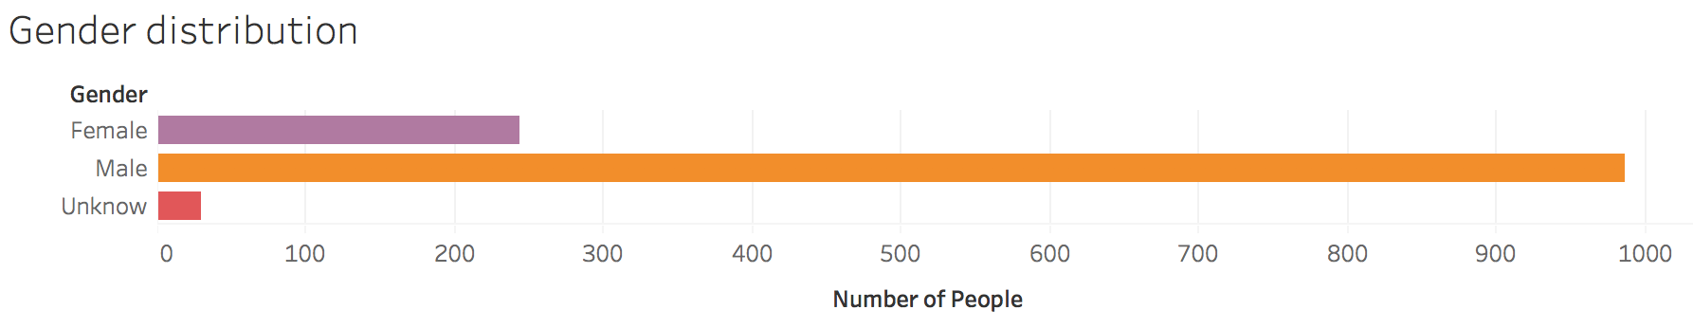
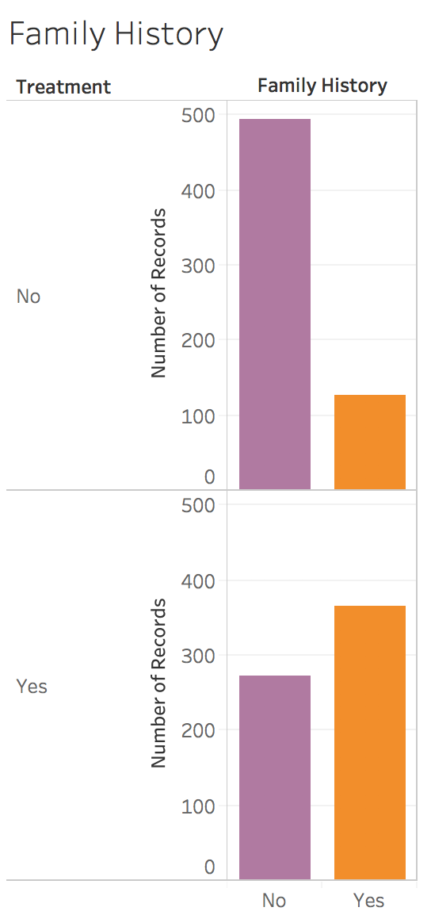
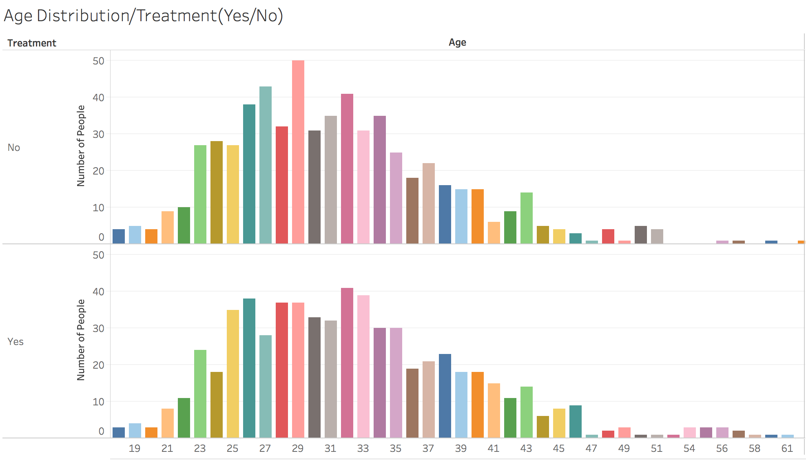
Trend

Slide 4
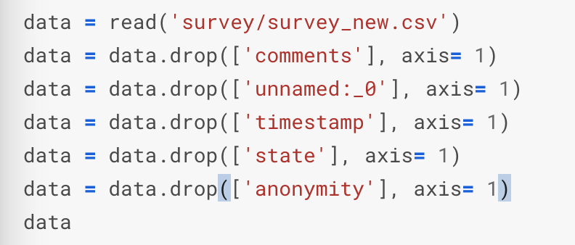
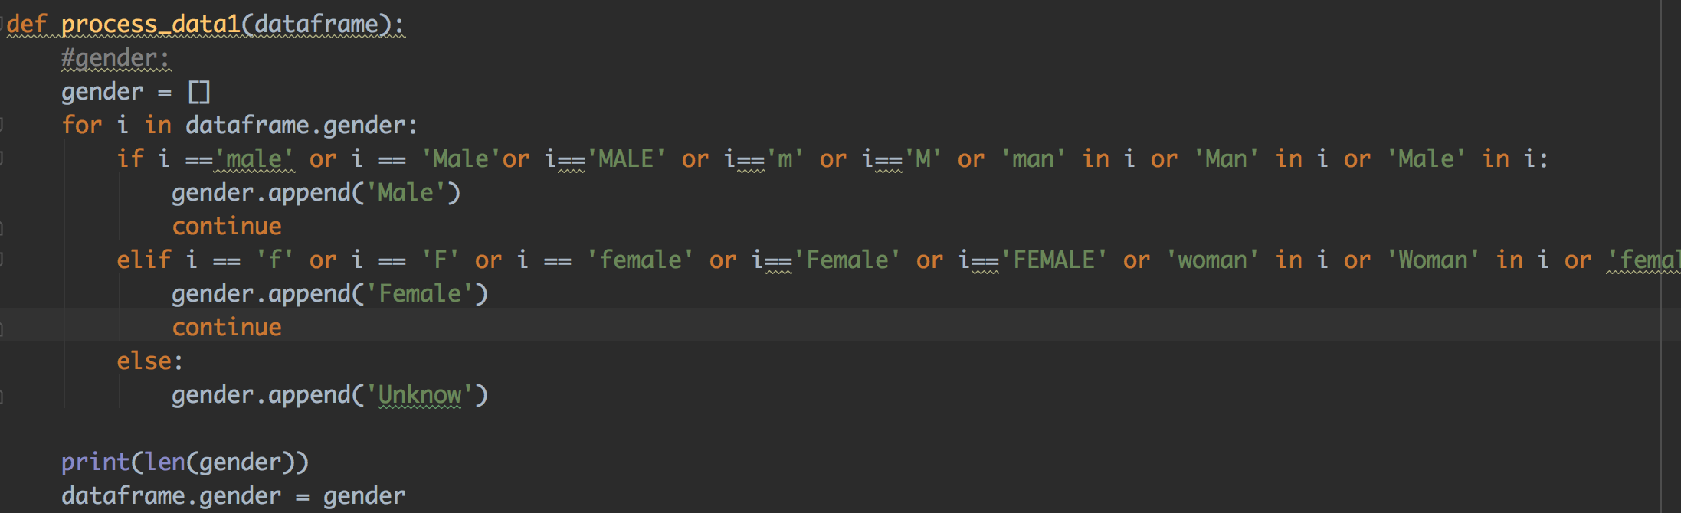
Data Process
1.Data cleaning:
(1) Get rid of variables, “timestamp”, “unnamed:_0”, “comments”, “state” to make the dataframe more easier.
(2) Cleaning all NaN
(3) Formalize the “Male” and “Female” in gender.

Slide 5
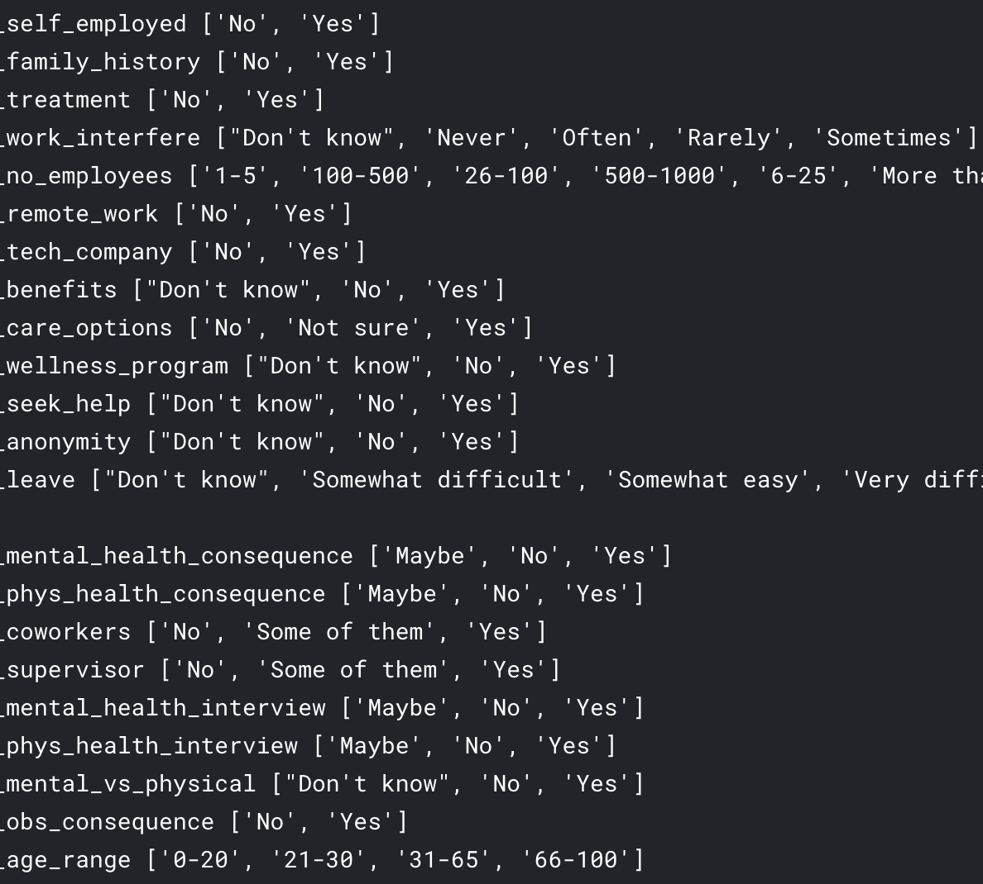
Data Process

Slide 6
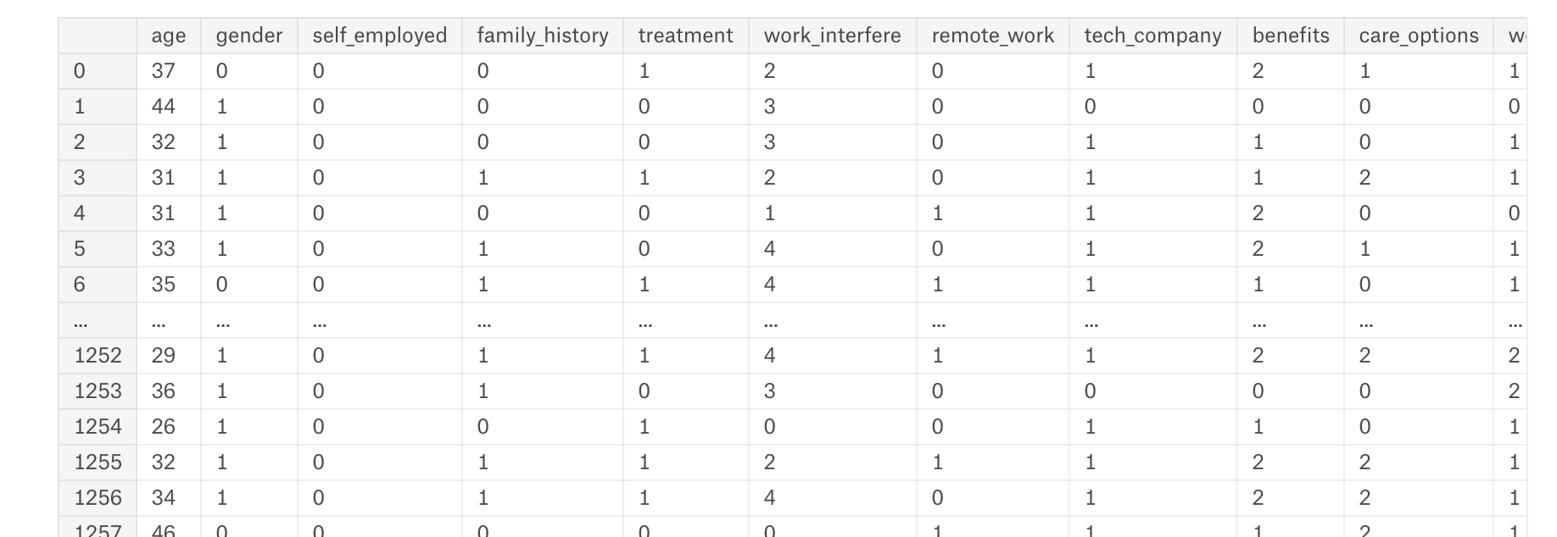
Data Process
2.Encoding Data
Using preprocessing in sklearn model to encode all the feature value

Slide 7
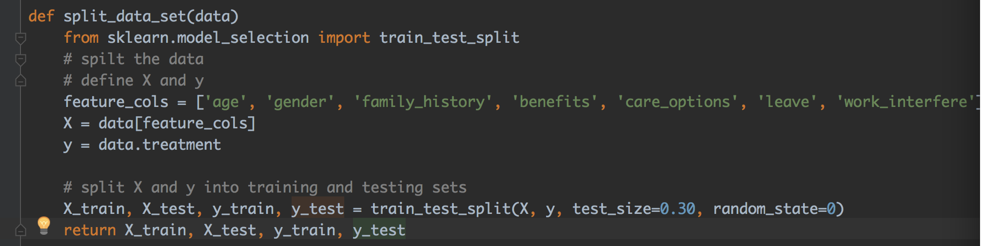
Data Process
3.Data Modeling
Get the train and test set
Create logistic regression model
Train the model
Using test set to evaluate the securaty

Slide 8
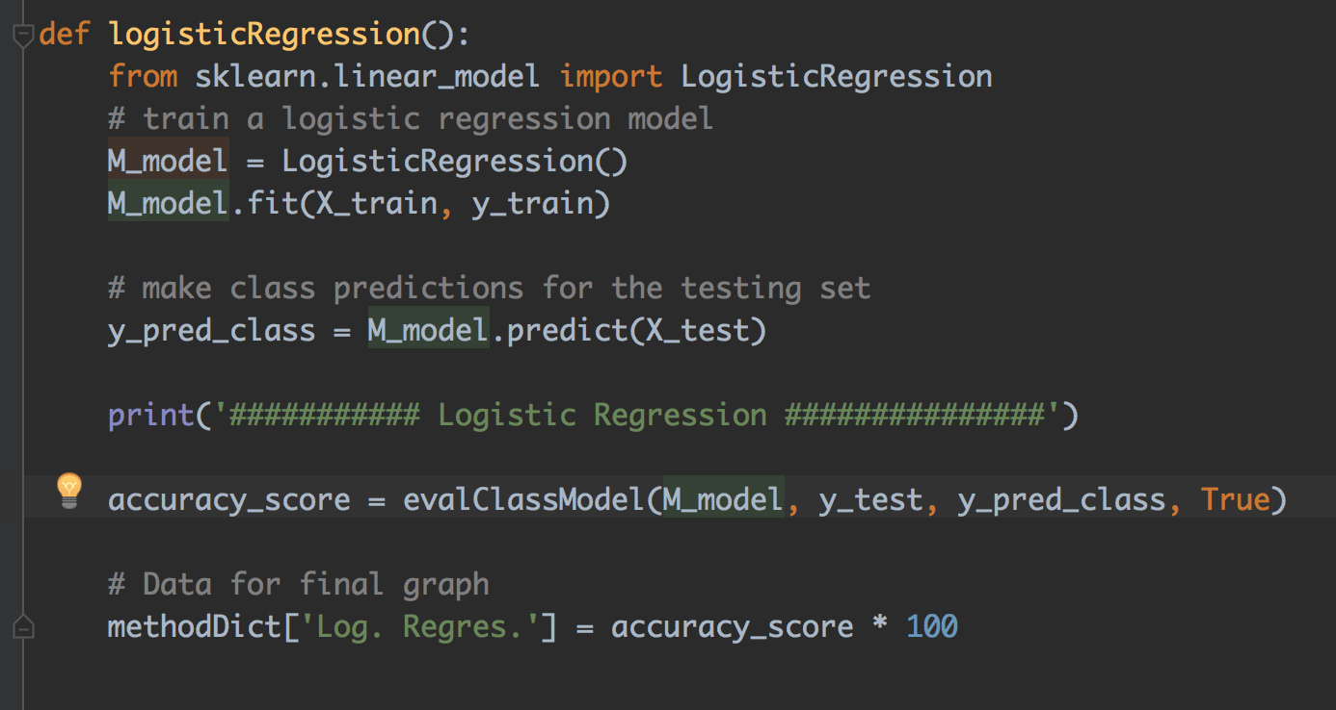
Data Process
3.Data Modeling
(3) Train the model
(4) Using test set to evaluate the accuraty

Slide 9
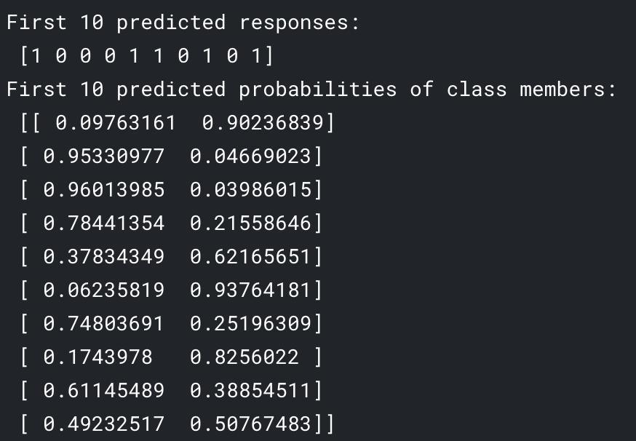
4.Output
Data Process

Slide 10
Thank you!

